Slide 1

Portfolio Optimisation using Monte Carlo Simulations
PANKAJ KUMAR
21119033
p_kumar2@me.iitr.ac.in

Slide 2




Objectives
To develop a Monte Carlo simulation model for portfolio optimization
To Include of stock, bonds and alternative investments
To analyze portfolios composed of asset classes
To maximize expected returns while managing risk.

Slide 3
Overview of the Approach
Acquire historical price data for a selection of assets, including stocks and bonds.
Analyze the data to calculate returns, and determine the mean returns and covariances between assets.
Create a portfolio optimization model that maximizes the Sharpe Ratio, a measure of risk-adjusted return.
Implement a Monte Carlo simulation to generate random portfolios, allowing us to explore different risk-return trade-offs.

Slide 4


DATA Import and Handling
DATA SOURCE
Imported data from Yahoo Finance
DATA RETRIEVAL
Takes data for 10 years (from January 1, 2012, to January 1, 2022) and obtained daily adjusted closing prices for the selected assets.

Slide 5












Companies in Focus
NIKE
ONGC
Goldman Sach
Oracle
Apple
Vanguard
Amazon
ITC Limited
UBS
Google
Uber
Artisan

Slide 6
MODEL IMPLEMENTATION

Slide 7
DATA ANALYSIS
LOG RETURN CALCULATIONS
We calculate Log returns as these are critical component for portfolio optimization
Marketing Strategy
With these log returns ,we further calculate the followings:
Mean daily returns
Covariance Matrix
Annualized matrix

Slide 8
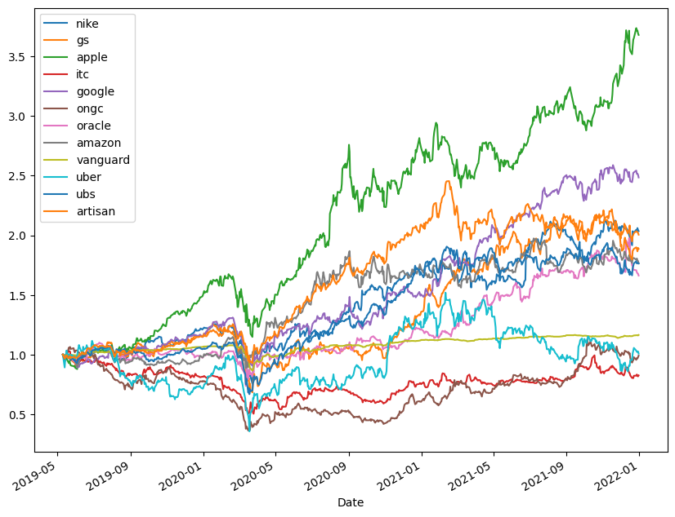
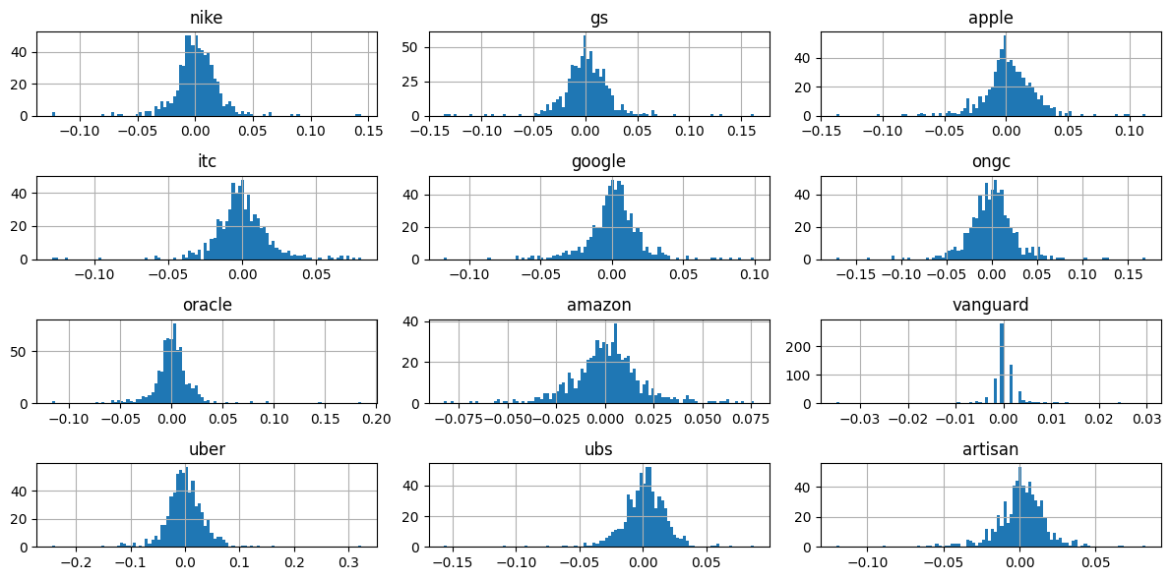
MARKET CONDITIONS OVERVIEW

Slide 9
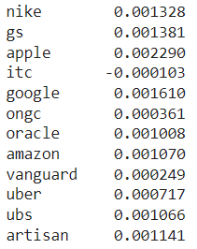
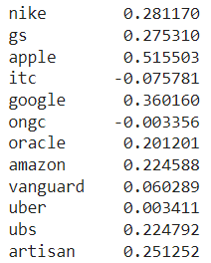
Market conditions
Mean Daily Returns
Annual Log Returns

Slide 10

Portfolio Optimization
1.Random Portfolio Optimization
Random Weights: Created random weights for each asset class.
Rebalancing: Rebalancing the weights to their sum to be 1.0.
2.Efficient Frontier and sharp ratio
Efficient Frontier: Define the efficient frontier as the set of portfolios with the highest expected return for a given level of risk (volatility).
Sharpe Ratio: Sharpe Ratio as a metric that quantifies the risk-adjusted return of a portfolio.

Slide 11
Portfolio Optimization
3.Initial Portfolio Creation
we create an initial portfolio allocation to serve as a starting point.
4.Monte Carlo Simulations
Generated a large number of random portfolios, by running the previous code 15000 times which describes how these simulated portfolios represent a range of risk-return profiles.

Slide 12
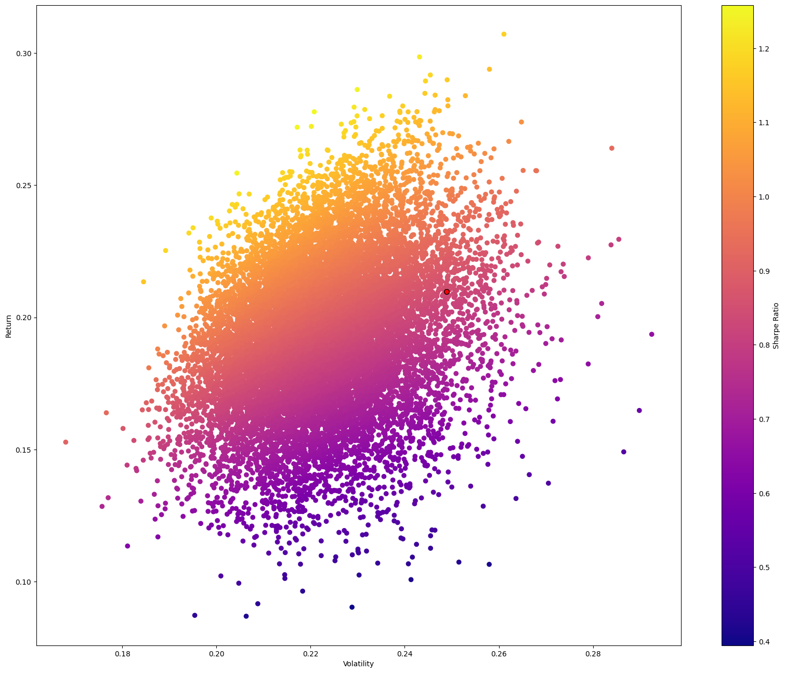
VISUALISING THE
RESULTS

Slide 13




Introduction of Risk Appetite
Constraints
Optimization Process
Optimal Weights Calculation
Portfolio Metrics
Risk Appetite: Define the investor's risk appetite.
Constraint Formulation: Describe the constraints imposed on the portfolio, such as ensuring their sum to be 0
Objective Function: maximizing the Sharpe Ratio.
Optimization Algorithm: Optimal portfolio allocation that meets the constraints while maximizing risk-adjusted returns
Optimal Portfolio Weights: Display the optimal weights assigned to each asset in the portfolio, including stocks and bonds.
Expected Return:
Expected Volatility
Sharpe Ratio

Slide 14




COMPARISON OF DIFFERENT RISK PROFILES
Aggressive
Moderate
Conservative
Expected Return: 0.4410 Expected Volatility: 0.2988 Sharpe Ratio: 1.4759
Expected Return: 0.3330 Expected Volatility: 0.2656 Sharpe Ratio: 1.2538
Expected Return: 0.2512 Expected Volatility: 0.2669 Sharpe Ratio: 0.9414

Slide 15
Conclusion
Monte Carlo simulation provides a robust method for exploring various portfolio scenarios and optimizing allocations.
Diversification remains a critical element in managing risk and enhancing risk-adjusted returns.

Slide 16





Thank You

